Slide 1

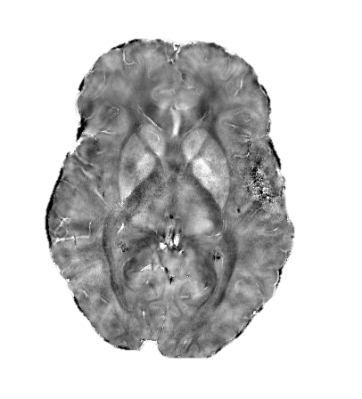
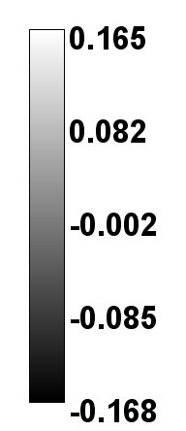
InBrain Workshop
QSM:
Quantitative Susceptiblity Mapping
ppm
Henrique Azevedo
josehenrique@usp.br

Slide 2
Introduction

Slide 3
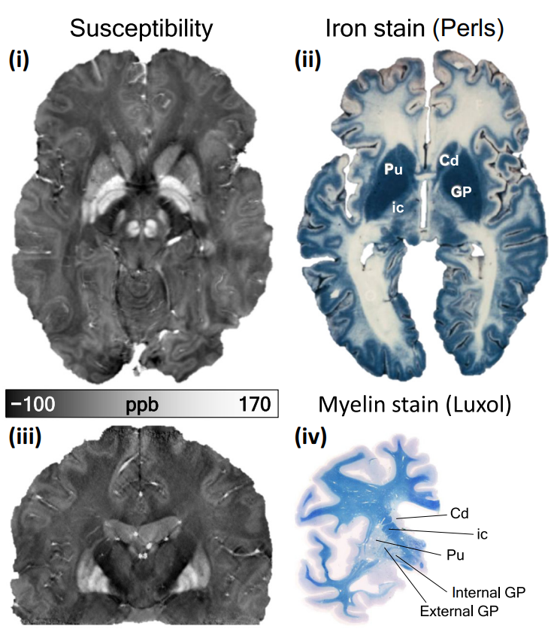
Quantitative Susceptibilty Mapping¹
Tissue’s bulk magnetic susceptibilty in vivo
Four major contributors: water, myelin, iron and calcium.
Trends in Neurosc. 42 (2019) 384-401
¹ Z. Med. Phys. 26 (2016) 6-34

Slide 4

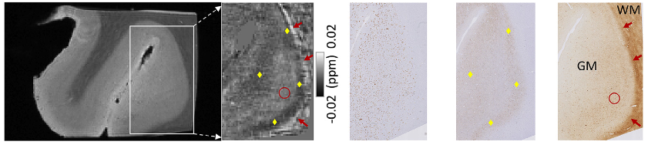
QSM applications
Amyloid-beta
tau
iron
T2*-weighted
QSM
Asses beta amyloid agregation and iron accumulation in Alzheimer’s disease

Slide 5
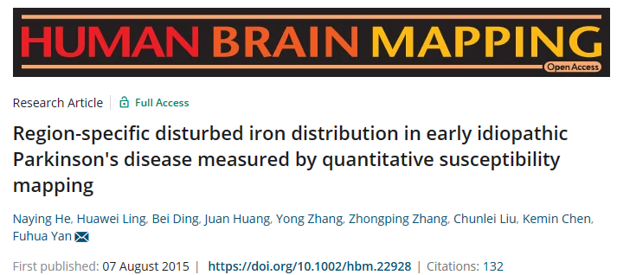
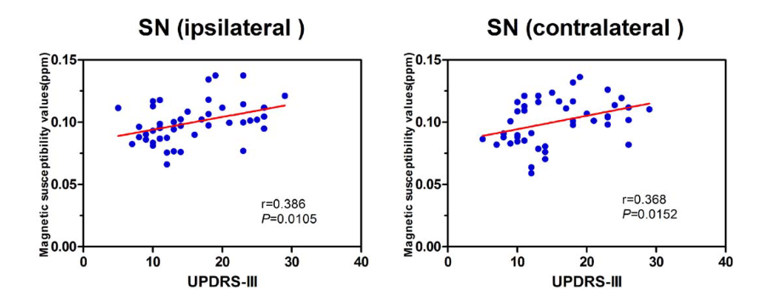
QSM applications
QSM value is positively correlated with scale that measures the progression of Parkinson disease

Slide 6
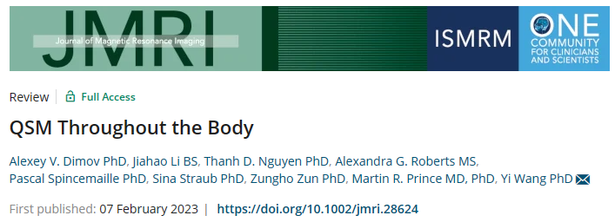
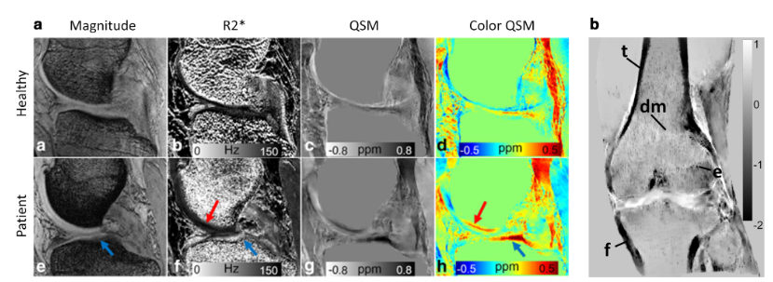
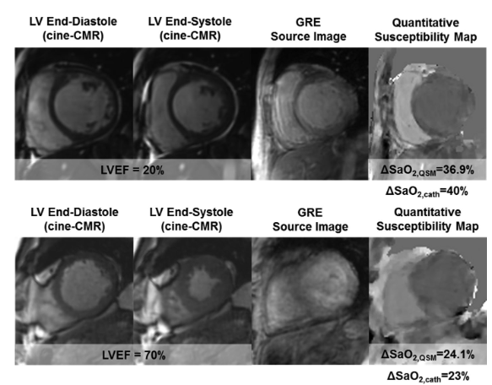
QSM applications
QSM to characterize medial cartillage damage in knee
QSM to characterize oxygen saturation non-invasively in heart

Slide 7
How to measure susceptibilty with MRI?

Slide 8
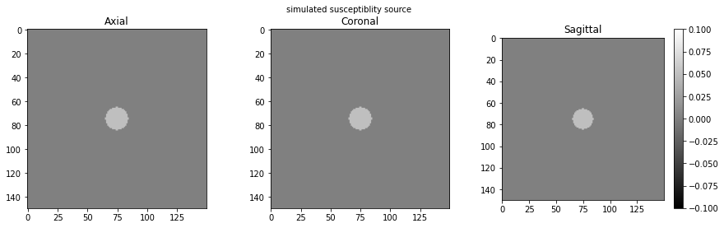
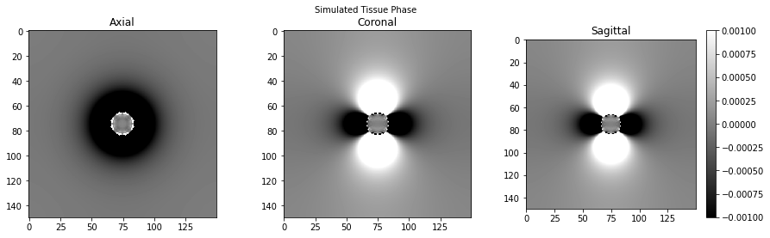
How to measure susceptibilty with MRI?
Susceptibility source
Field pertubation
B₀

Slide 9
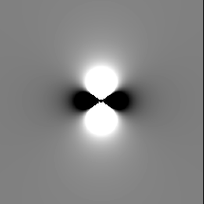

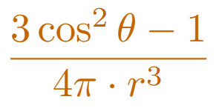
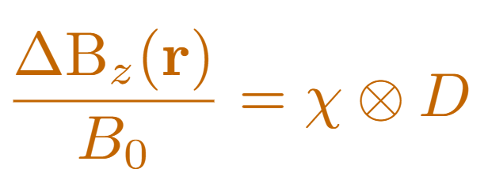
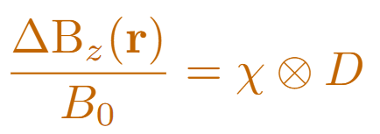
How to measure susceptibilty with MRI?
Susceptibility source
Dipole field
Field pertubation

Slide 10
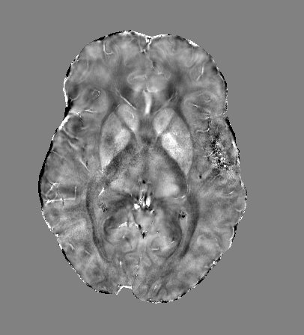
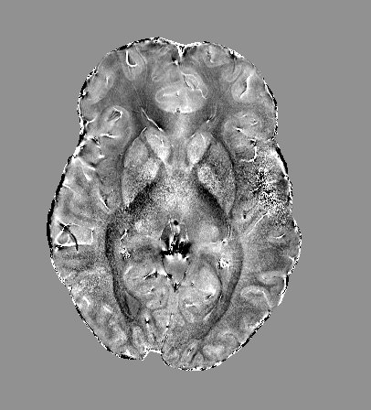

Suscep. source
Dipole
Field distrib.
Field distrib.
Dipole
Suscep. source
Fourier Transform of Field distrib.
Fourier Transform of Susc. Source
/
-1

Slide 11
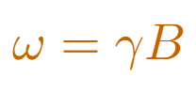
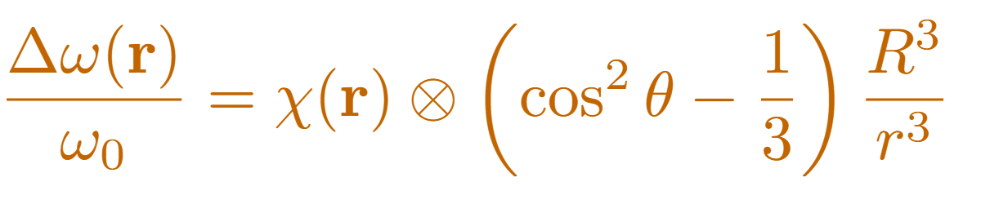
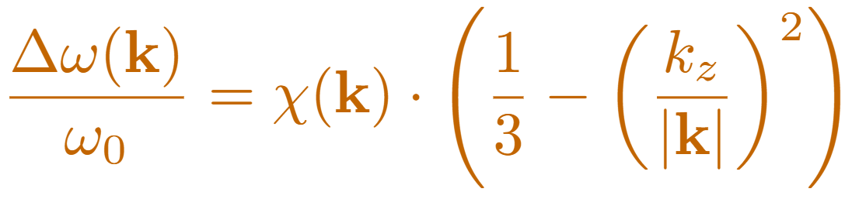
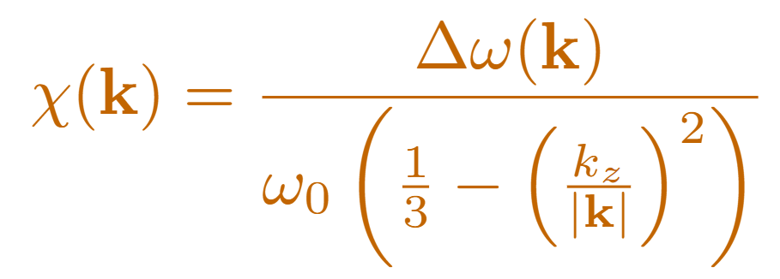
Field distrib.
Dipole
Suscep. source
-1
Convolution
theorem

Slide 12
QSM pipeline

Slide 13
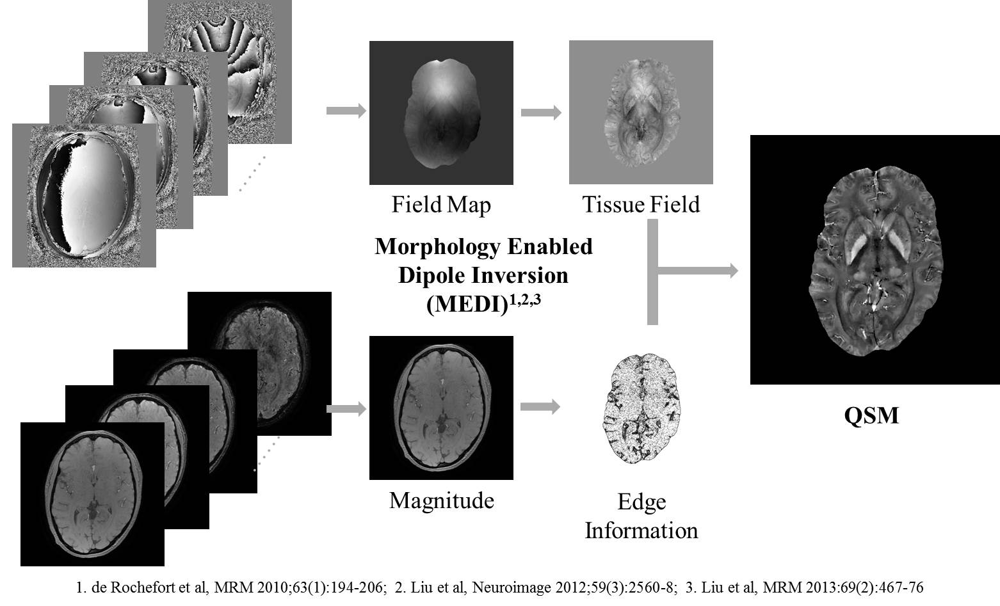
QSM processing steps

Slide 14
Hands - on

Slide 15
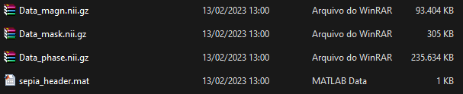
Knowning the data
Magnitude – magnitude images at 4 echos
Phase – phase images at 4 echos
Mask – mask of the brain
Sepia_header – informations such as echo times (TE) , magnetic field strenght in Tesla, orientation of the aquicsition.
https://drive.google.com/drive/folders/1ACVtOer_pq7_Y_Mnj4u4ML-w_5HYfpJQ?usp=sharing

Slide 16
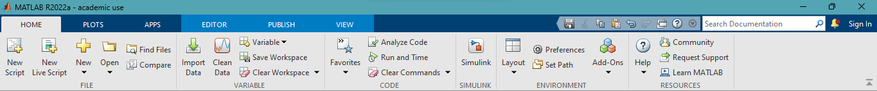
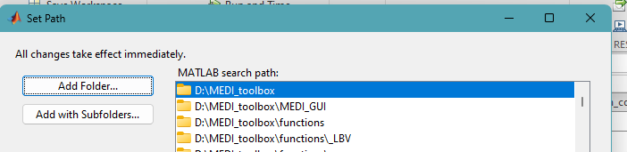
MEDI toolbox: http://pre.weill.cornell.edu/mri/pages/qsm.html
“/usr/local/inbrain/QSM_toolbox/MEDI_toolbox”

Slide 17
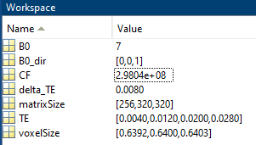
Information to obtain maps with correct units
Magnetic field strenght (T)
Magnetic field Direction (x, y, z)
Frequency - B0*gamma (Hz)
Echo spacing (s)
Image matrix size
Echo times (s)
Spatial resultion (mm)

Slide 18
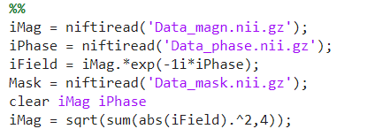
Load the data at Matlab workspace
https://drive.google.com/drive/folders/1ACVtOer_pq7_Y_Mnj4u4ML-w_5HYfpJQ?usp=sharing

Slide 19
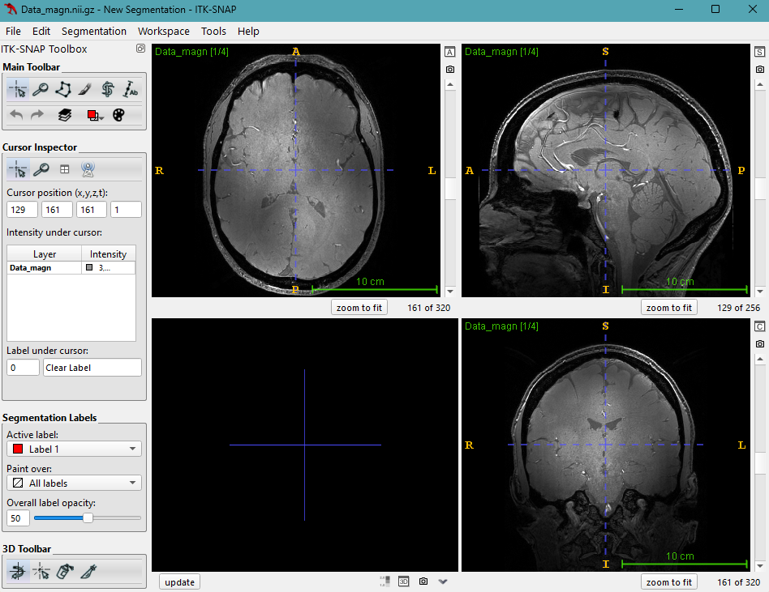
View the data
Terminal de comando → “itksnap”
ITK-SNAP → File → Open Main Image → Browse...
“/usr/local/inbrain/QSM_Data/Data_1”

Slide 20
View the data

Slide 21
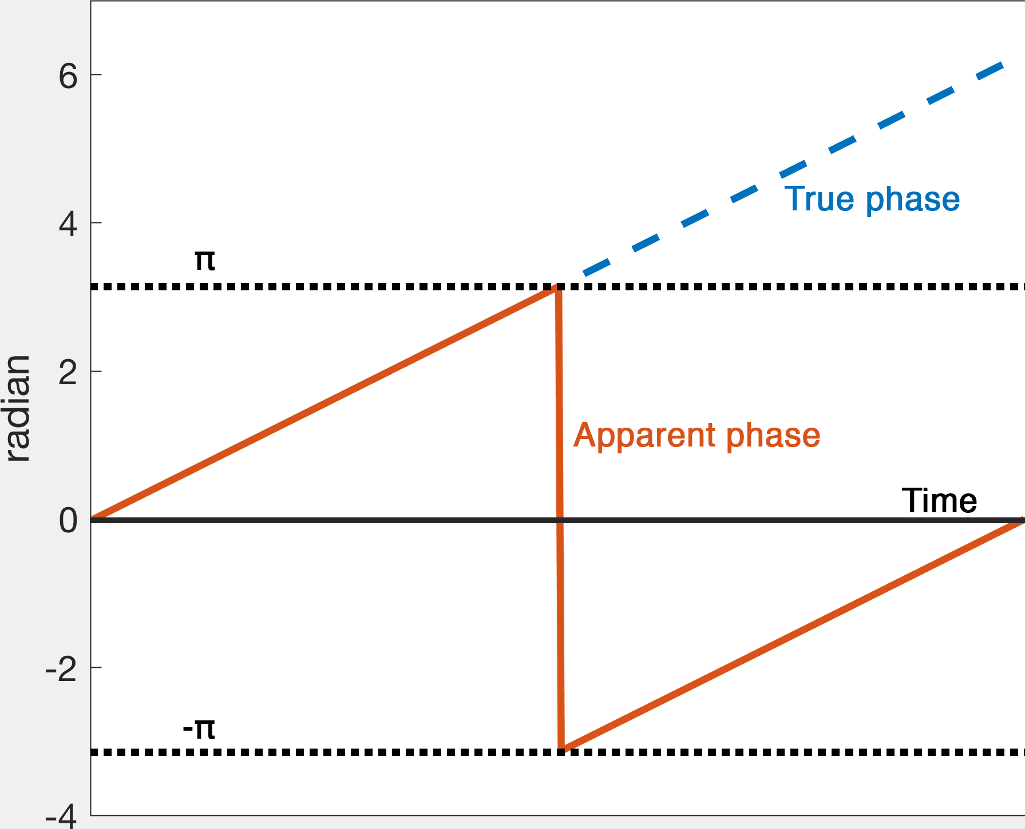
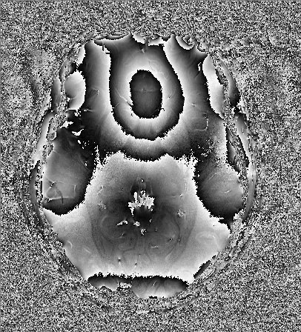
Phase unwrapping
The “wraps” occurs because phase information is restrained to [-π, π] interval
Every time that phase value lays outised this interval an addition or subtraction of π is done

Slide 22
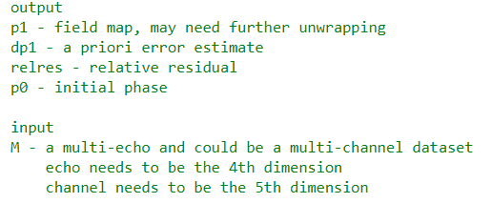
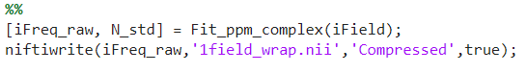
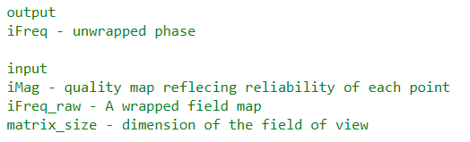
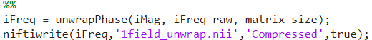
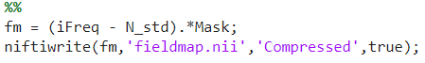
Phase unwrapping
First step – Nonlinear fit of phase between echos
Second step – Spatial unwrap of phase
Thrid step – Field map

Slide 23
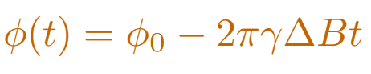
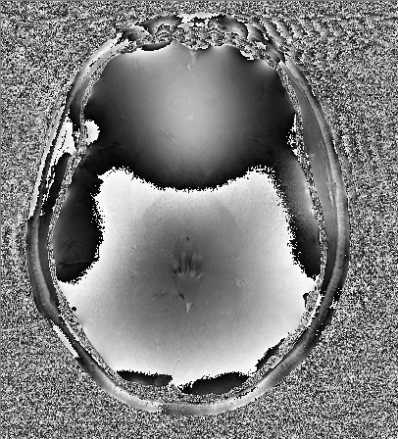
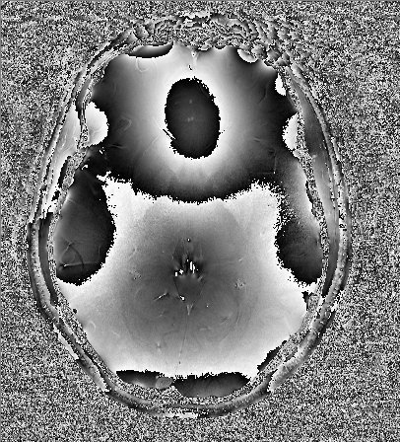
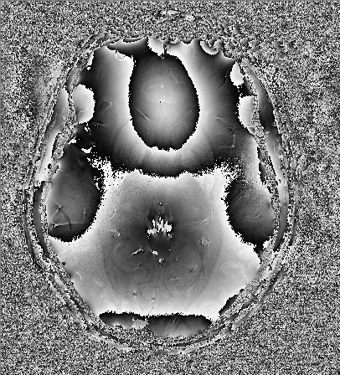
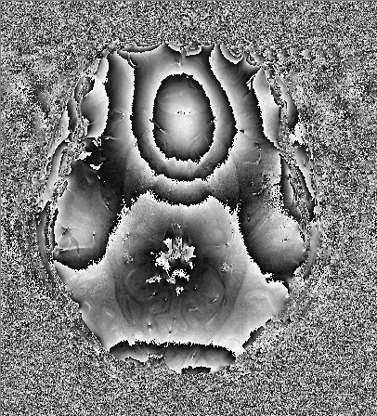
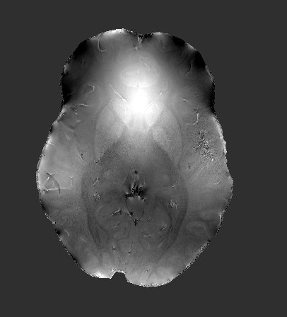
Phase unwrapping
MEDI nonlinear fit
Phase wraps over echos times are removed to estimate the slope of phase variation over time and the correspondign value of ΔB
Phase unwrapping: Laplacian (MEDI)
The resultant phase was spatially unwrapped using Laplacian operator formulation.

Slide 24
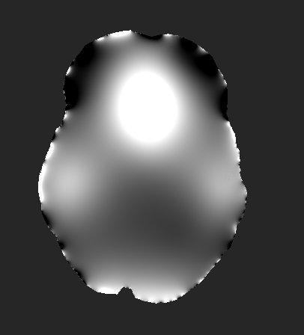
Background field removal
=
+

Slide 25
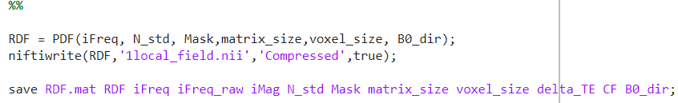
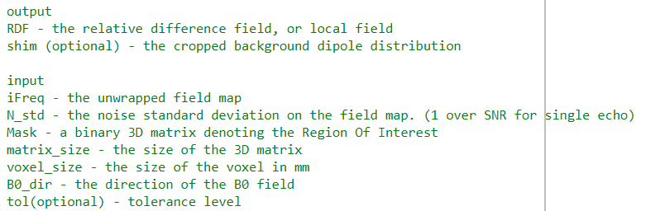
Background field removal

Slide 26
Background field removal
Projection onto Dipole Field (PDF)
Magnetic field for a dipole outside a ROI is approximately orthogonal to the magnetic field of a dipole inside the ROI.
B_{int}
B_{bck}
B = B_{int}+ B_{bck}

Slide 27
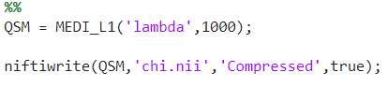
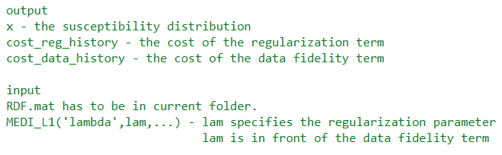
Quantitative susceptibilty
mapping

Slide 28
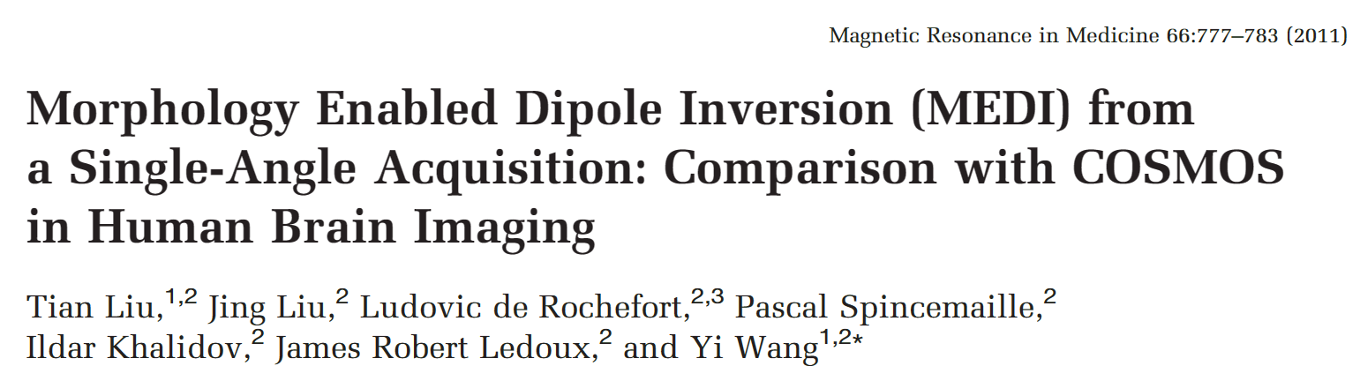
Quantitative susceptibilty
mapping
Morphology Enabled Dipole Inverse (MEDI)
Edges in susceptibilty are nearly the same as magnitude images obtained at the same acquisition.
Employ a weighted l1 minimization method that penalize susceptibilty values at those voxels that are not part of magnetization image

Slide 29
THANK YOU!

Slide 30

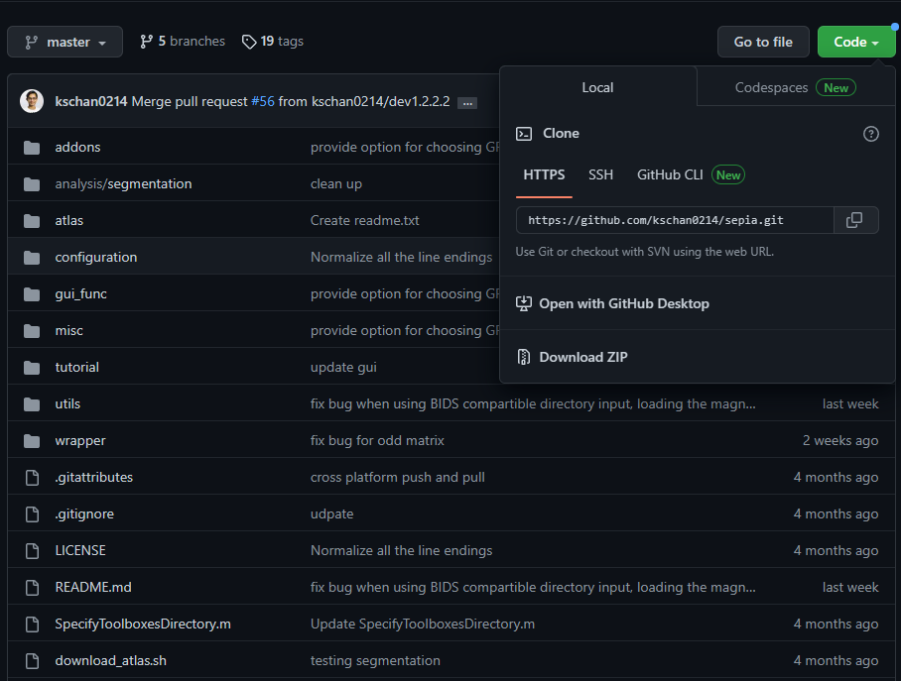
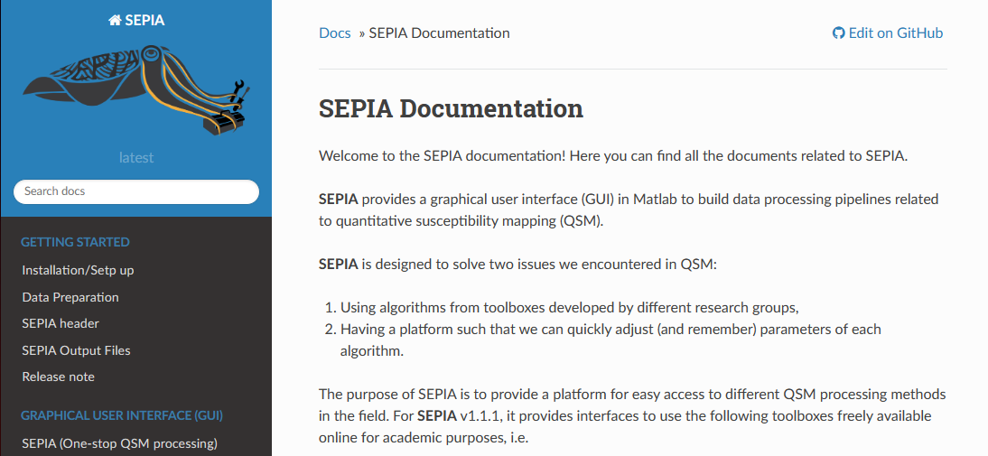
SEPIA toolbox
Download:
https://github.com/kschan0214/sepia
Documentation:
https://sepia-documentation.readthedocs.io/en/latest/

Slide 31
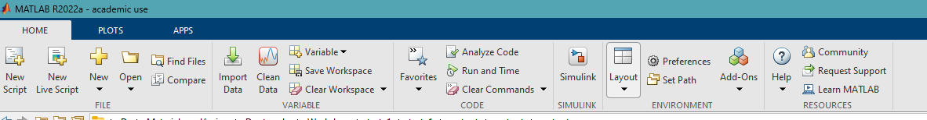



In MATLAB: Set Path → Add Folder → sepia/directory → Save
In MATLAB: type “sepia” on Command Window and click enter

Slide 32

In SEPIA: Utility→ Manage Dependency → Add directory for each toolbox

